Slide 1
Newport News Shipbuilding
A Division of HII

Slide 2
Newport News Shipbuilding
Newport News Shipbuilding is the sole designer, builder, and refueler of U.S. Navy Aircraft Carriers and one of two providers of U.S. Navy Submarines. NNS designs, builds, maintains, and inactivates the most advanced ships in the world using its expertise in nuclear propulsion, naval design, and manufacturing. NNS is also the largest industrial employer in Virginia, with approximately 25,000 employees.

Slide 3
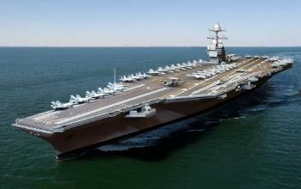
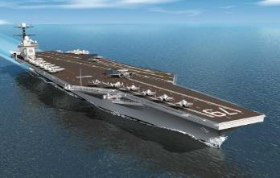
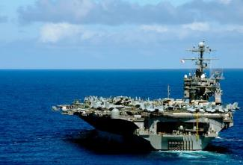
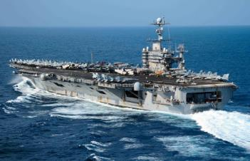
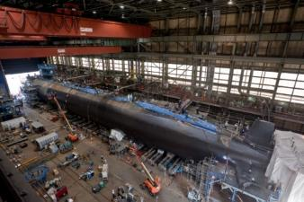
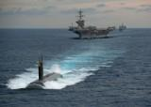
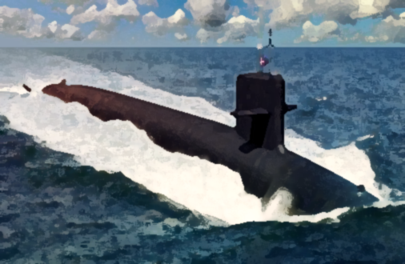
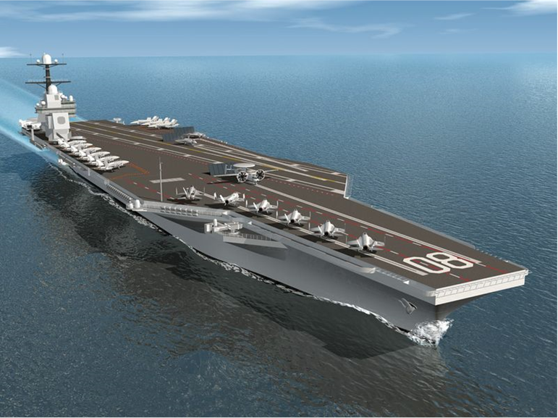
NNS Navy Programs
Gerald R. Ford (CVN 78)
Carrier New Construction
Plan Incremental Availability (PIA)
September 2022
John F. Kennedy (CVN 79)
Detailed Design and Construction
Delivery 2024
USS George Washington (CVN 73)
RCOH
Complete Post Availability Complete February 2023
USS John C. Stennis (CVN 74)
Started Execution in January;
Planned arrival to NNS May 1, 2021
Virginia Class Submarine (VCS)
15 Boats Under Construction
Fleet Support
Worldwide
Working all 10 NIMITZ Class CVNs, USS Gerald R. Ford (CVN 78) & all Submarines Classes
Columbia Class Submarines (CLB)
Design and Construction
Currently two Boats under construction
Enterprise/Doris Miller (CVN 80/81)
Keel for CVN 80 is scheduled for 4/30/22

Slide 4
NNS Buying Offices
Raw Material, Hardware and Small Electrical Components
Valves, Fittings, Filters and Strainers
Complex Deck Machinery
IT (Hardware, Software & Services)
Maintenance Repair Operations, Construction, Engineering and Facilities Services
Business Services
Complex Electrical Components
Build to Print, Make/Buy, Shipboard Subcontracted Materials
Shipboard Subcontract Services
Outsourcing & Complex Build to Print

Slide 5
Raw Material, Hardware and Small Electrical Components Buying Office
Responsible for Procurement of Raw Materials Including:
Steel Plate and Shapes
Pipe
Fittings
Paint
Coatings
Insulation
Abrasives
Lumber
Small Electrical Components
Potential Opportunities:
Textiles
Insulation
Ferrous and Nonferrous Sheets & Shapes
Plastics
Fasteners
Tape
Adhesives
Chemicals and Compounds
Rigging Material
Safety Equipment
Tools
Hardware
Bottles and Cylinders

Slide 6
Valves, Fittings, Filters and Strainers Buying Office
Responsible for Procurement of Various Complex Valves, Fittings, Filters and Strainers to Support Ship Construction, Overhaul and Fleet Support:
Valves
Standard Navy Valves
Ball Valves
Butterfly Valves
Check Valves
Gate Valves
Globe Valves
Swing Check Valves
Regulator Valves
Relief Valves
Throttle Valves
Potential Opportunities:
Standard Navy Valves
Fittings
The use of new technologies such as Additive Manufacturing
Manifolds
Strainers
Filters
Air
Lube Oil
Waste
Water
Pipe Fittings
Formed Fittings
Machined Fittings
Expansion Joints

Slide 7
Complex Deck Machinery Buying Office
Responsible for Procurement of Various Complex Mechanical Components and Systems in Support of New Construction and Refueling and Complex Overhaul (RCOH) Carrier Programs:
Plasma Arc Waste Destruction System (PAWDS) and Other Solid Waste Disposal Systems
Turbines & Secondary Propulsion Systems
Advance Weapons Elevators (AWEs) and Component Systems
Main Condensate Pumps
Distillers and Distillation Pumps
Air Turbine Pumps
Coolers/Heat Exchangers
Non-Destructive Test (NDT) Equipment
Potential Opportunities:
Actuators (AWEs)
Stators (AWEs)
PAWDS
Galley Ventilation Systems
Coolers/Heat Exchangers
Acoustic Valves
Arrays
Air Purification Systems
Reverse Osmosis Systems and Lube Oil Coolers
Winches, Cranes and Hoists
Wastewater Treatment & Disposal Systems
Vaneaxial Fans and Air Filtration Systems
Galley Ventilation Systems and Main Refrigeration Units (MRUs)

Slide 8
IT Hardware, Software and Services Buying Office
Responsible for Procurement of Information Technology (IT) Hardware, Software and Services:
Computer Programs
Cell Phones
Telecommunication System
Travel Services/System
Printers
Potential Opportunities:
IT Staff Augmentation
Off the Shelf IT Hardware/Software
Internet Service
Credit Cards
Computers
Internet Domain Names
Be advised some products/services are under long term agreements

Slide 9
Maintenance Repair Operations
Responsible for Procurement of Maintenance Repair Operations:
Fuels
Maintenance – Elevator, Cranes
Cars, Trucks, Other Vehicles – Maintenance
Safety Supplies and Tools
Shipyard Garage Services
Welding Metal and Equipment
Metrology Equipment

Slide 10
Construction, Engineering and Facilities Services Buying Office
Responsible for Procurement for Construction, Engineering and Facilities Services:
Construction Projects
Corporate Jet
Utilities – Electric, Gas
Capital Equipment
Potential Opportunities:
Engineering Services
General Contractors
Mechanical Services
Design-Build Services
Lead/Mold/Asbestos Abatement
Building Renovations
Furniture
Engineering Services
High Voltage Electrical Services
Diving Services
Dredging Services
Industrial Machinery (i.e. CNC, Boring Mills, etc.)
Roofing Contractors

Slide 11
Business Services Buying Office
Responsible for Procurement of Business Services:
Janitorial Services
Lawn Care
Transportation/Freight
Bicycle Services
Reproduction
Safety Supplies and Tools
Security Guards
Potential Opportunities:
Food Services
Humane Society – Cat Control
Bicycles
Lawn Services
Plaques
Shipyard Garage Services
Pest Control
Freight Providers
Various Long Term Agreements
Engineering Services
Moving Services
Credit Cards
Benefit Programs
Insurance Benefits, Employee Assistance Program (EAP), Health, Dental
Advertising – Billboards, Newspaper, Wall Street

Slide 12
Complex Electrical Components Buying Office
Responsible for Procurement of Various Electrical Materials and Complex Systems to Support Ship Construction:
Motor Controllers
Frequency Converters
Degaussing
Voltage Regulators
Networks – Video, Computers
Lighting
Power Switchboard, Circuit Breakers
Potential Opportunities:
Transmitters
Frequency Converters
Relays
Detectors, Gauges, Monitors Circuit Boards
Load Centers
Panels, Enclosures
Electric Motors
Salinity Cells
Telecommunications

Slide 13
Make/Buy, Build to Print, Shipboard Subcontracted Materials Buying Office
Responsible for Procurement of Various Complex Components to Support Ship Construction:
Coamings, Foundations, Ventilation, Other Machined Items
Complex Components
Subcontracting - Component Fabrication and Assembly (CFA)/Structural Fabrication and Assembly (SFA)
Castings and Forgings
Propulsion Shafting and Propellers
Potential Opportunities:
Build to Print Supporting Direct Buys and Subcontracted Work
Fixtures
Hangers/Mounts
Water Tight Doors
Shafting

Slide 14
Shipboard Subcontract Services Buying Office
Responsible for Procurement of Various Complex Services to Support Ship Construction:
Engineering Services
Independent Research and Development
Contract Research and Development
Leased Labor and Subcontracted Services
HII-Fleet Support Group
Corporate and NNS Consultant Support
Southwest Regional Maintenance Center - San Diego, California
Potential Opportunities:
Subcontracted Work
Marine Preservation
Scrapers

Slide 15
Outsourcing & Complex Build to Print Buying Office
Responsible for Procurement of Outsourcing Demand, Complex/Structural and Buy Commodities:
Outsourcing
Shops
CFA – Machine Shop/Sheet Metal/Powder Coat & Coatings
SFA – Rolling/Forming/Fab/Plate Flattening
Structural Assembly
CVN Base A’s
CLB Bulkheads & Superstructure
VCS HAB Decks
Commodity Buys
Shafting & CVN Propellers
Built-up Tees
Sea Chests
Forgings
Torpedo Tubes
Cylinders, Door Assemblies, Interlocks
Water Tight Doors
Air Flasks
Fixtures
Large Structural & New Design CLB
Top Side Fairing (VPM)

Slide 16
How to Become an NNS Supplier
16

Slide 17
Prospective Supplier Program
Companies Interested in Becoming a NNS Supplier Should Complete a Prospective Supplier Form Located on the Newport News Shipbuilding Suppliers Website:
https://supplier.huntingtoningalls.com/sourcing/index.html

Slide 18
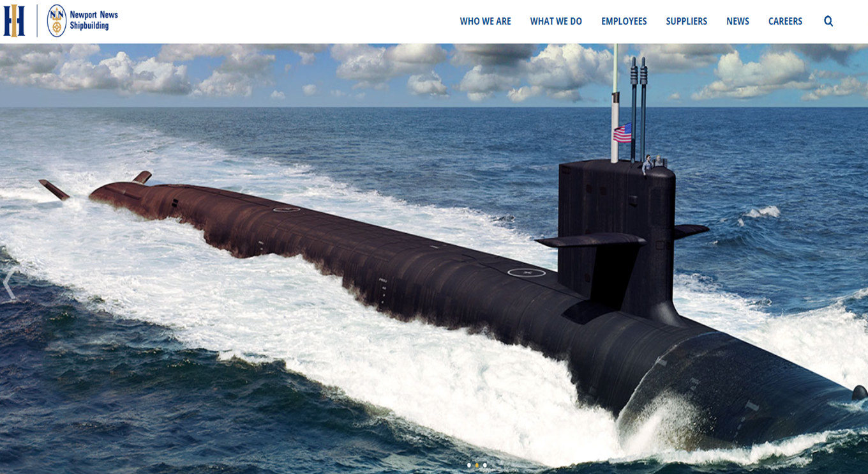
NNS Webpage Navigation
https://nns.huntingtoningalls.com

Slide 19
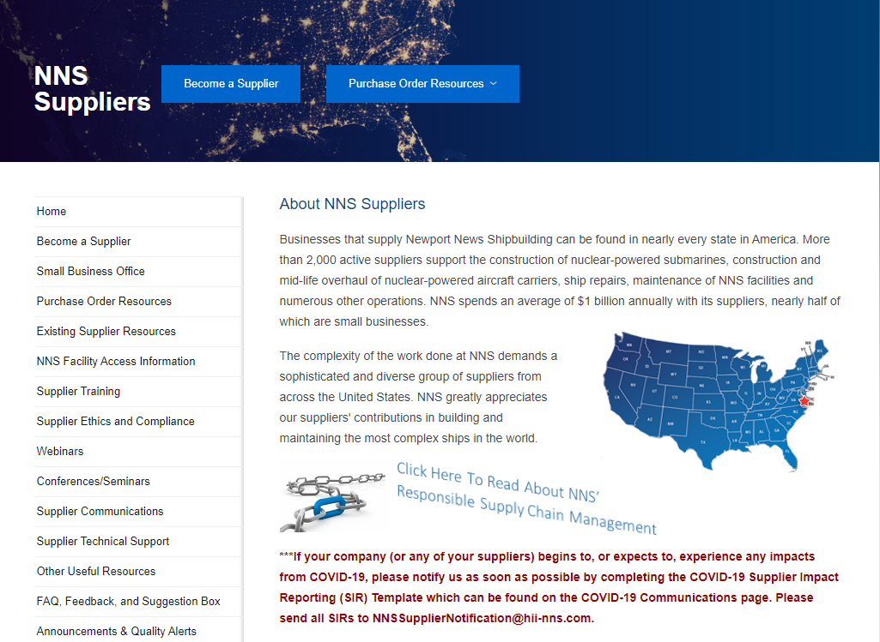
NNS Suppliers Webpage Navigation
https://supplier.huntingtoningalls.com

Slide 20
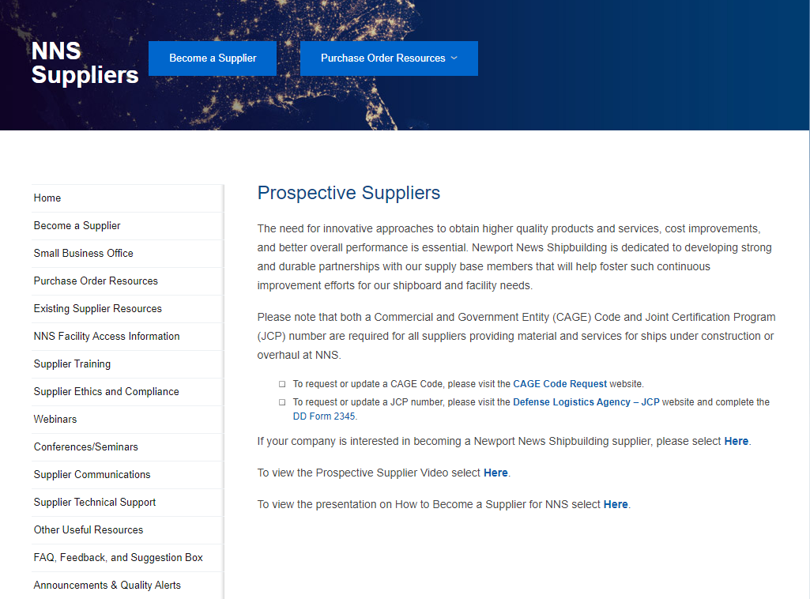
Prospective Suppliers Webpage
https://supplier.huntingtoningalls.com/sourcing/become-a-supplier/

Slide 21
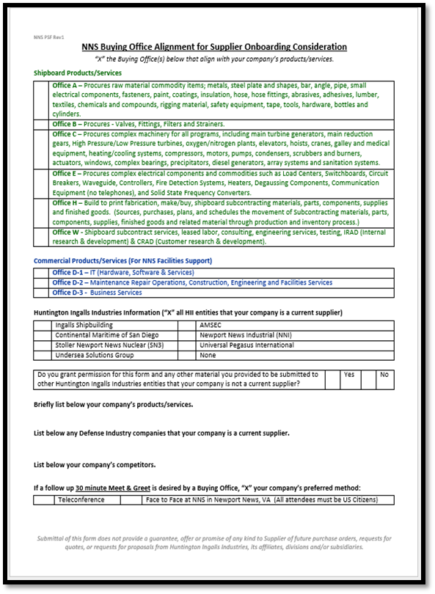
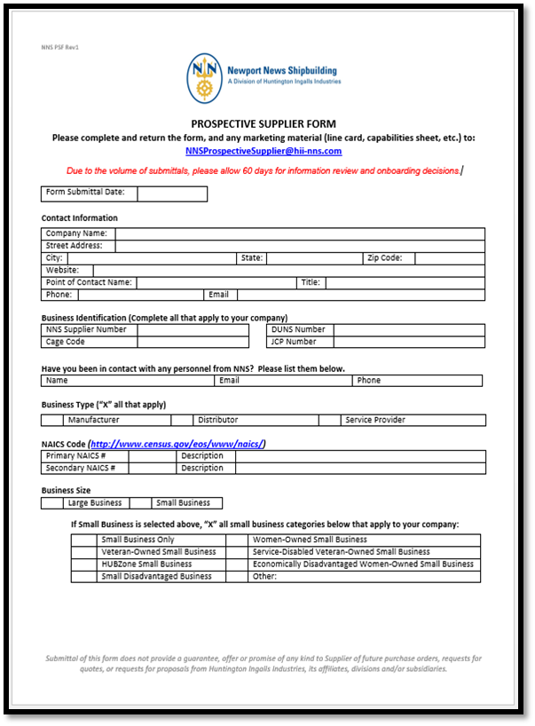
Fill Out Prospective Supplier Form
The Information Includes:
Contact Information
Business Identification
NNS POC
Business Type
North American Industry Classification System (NAICS) Codes
Business Size
NNS Buying Office Alignment
HII Supplier Status
Company’s Products/Services
Defense Industry Company Status
Company’s Competitors
“Meet and Greet” Preference
Email form to NNSProspectiveSupplier@hii-nns.com
Include Marketing Materials – Line Card, Capabilities Sheet, Competency Statement

Slide 22
Prospective Supplier Form Continued
Joint Certification Program (JCP): A certification required by U.S. contractors that wish to obtain access to unclassified technical data disclosing military critical technology that is under the control of, or in the possession of the Department of Defense (DoD).
NNS Personnel can only exchange Unclassified Technical Data (UTD) with suppliers that have an active JCP.
The JCP is managed by the Defense Logistics Agency (DLA).
A JCP certification establishes the eligibility of a U.S. or Canadian contractor to receive UTD.
For more information please refer to the following website: https://www.dla.mil/HQ/LogisticsOperations/Services/JCP/
System for Award Management (SAM): Any government, business, grantee or organization (known as an “Entity” in SAM) wishing to do business with the federal government under a Federal Acquisition Regulation (FAR)-based contract is required to registered in SAM. NNS highly encourages its suppliers and prospective suppliers to register in the SAM database. (www.sam.gov)

Slide 23
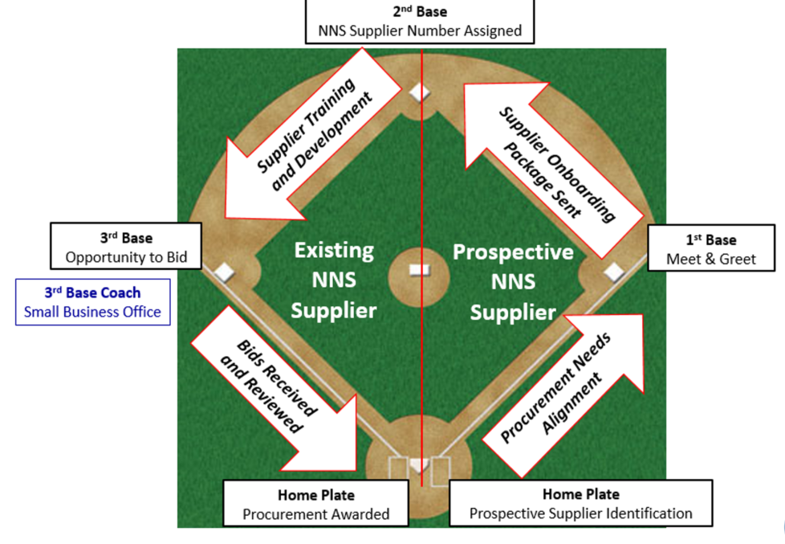
NNS Supplier Base Path

Slide 24
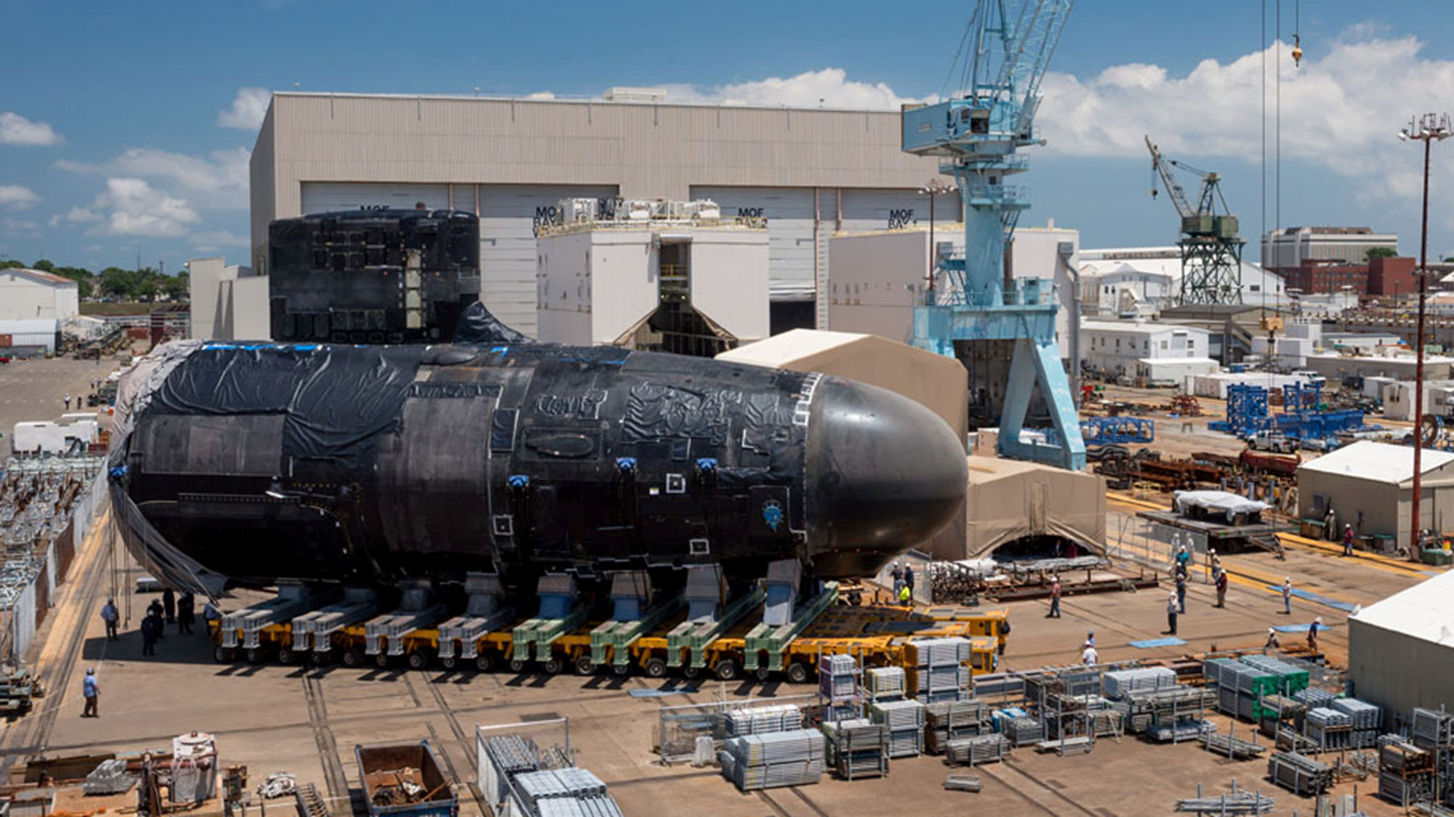
NNS Supplier Base Process
Home Plate (Batter’s Box)
Supplier Emails the Completed Prospective Supplier Form and Marketing Material to NNSProspectiveSupplier@hii-nns.com
NNS Stakeholders Review Supplier Information, Align it With Procurement Needs and Decide Whether to Pursue Supplier
If NNS Decides not to Pursue Supplier, Supplier Will be Notified via Email
If NNS Pursues Supplier, Then a Face-to-Face or Telephone “Meet and Greet” is Scheduled
First Base
The “Meet and Greet” is a 30 Minute Discussion Between the Supplier and NNS Stakeholders
Following the “Meet and Greet” NNS Stakeholders Decide Whether to Onboard the Supplier
If NNS Decides to not Onboard Supplier, the Supplier may be Considered for the TryRFQ Process. In Either Case, the Supplier will be Notified via Email.
If NNS Decides to Onboard Supplier, Supplier Receives an Email With Supplier Data and Supplier Quality Forms to Complete
Once Forms are Submitted and Accepted, a Supplier Number is Assigned

Slide 25
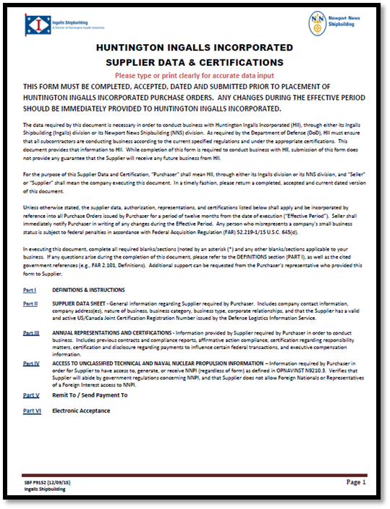
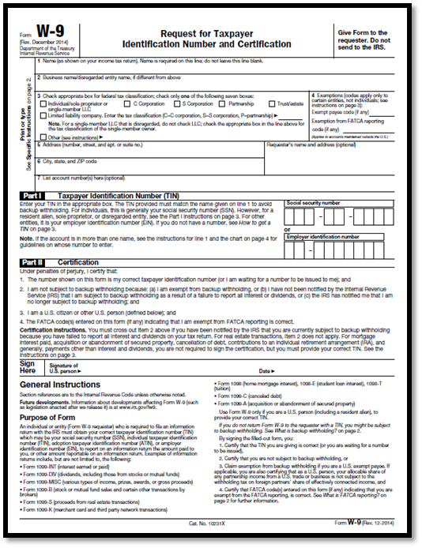
On-Boarding New Suppliers – Supplier Data
If NNS Decides to Pursue Business With a Supplier, the Supplier Must Complete the Supplier Data &Certifications Form, W-9 Form and Authorization of Electronic Funds Transfer Form
The Information Includes:
Company Name/Addresses
Cage Code
NAICS Codes
D-U-N-S Number
Tax ID Number
Banking information
Legal Entity Type
Business Type and Concern
Certifications
Supplier Data must be updated annually

Slide 26
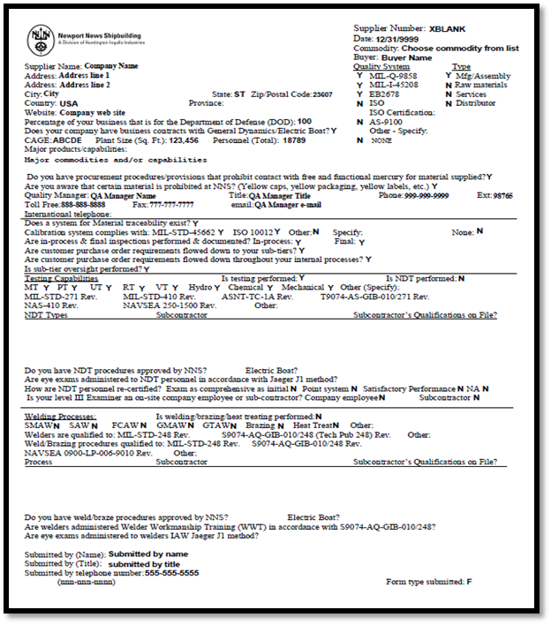
On-Boarding New Suppliers – Supplier Quality
Depending on the Products or Services Being Procured, Suppliers may Have to Provide Information Regarding Their Quality Program
NNS Supplier Quality Periodically Conducts On-site Audits
The Information Includes:
Company Name
Manufacturing Addresses
Quality Systems Certifications
Quality Assurance Manager
Material Traceability Process
Testing Capabilities
NDT Procedures/Qualifications
Welding Procedures/Qualifications

Slide 27
On-Boarding New Suppliers – Supplier Quality Continued
Terms and Conditions: The supplier should review NNS Appendix A-DoD Contracts and Appendix A-DoD Contracts Supplement on our Supplier gateway, and the invoked FAR/DFARS clauses.
Quality Systems:
In general, most material suppliers should have a quality system that generally conforms to ISO9001 / MIL-I-45208 / EB Spec 2678.
Review of NNS Appendix B on our supplier gateway will provide a flavor for specific technical requirements for many specifications that we order
Flowdown of technical, quality, and contractual requirements from NNS Purchase Orders to sub-tier suppliers and contractors should be a feature of the supplier’s purchasing and quality systems
Fabrication Welding and Non Destructive Testing (NDT): A supplier of items requiring fabrication welding and NDT should be capable of, or willing to develop, conforming to Navy TechPub 248 and TechPub 271 welding and NDT systems.
As Seller-Offeror, you are expected to receive Controlled Unclassified Information (CUI), which is subject to the requirements of 32 CFR Part 2002 (the “CUI Regulation”), and in some cases also with DFARS 252.204-7012, Safeguarding Covered Defense Information and Cyber Incident Reporting (the “DFARS clause”), in support of bid and proposal activities of Huntington Ingalls Incorporated (HII). In order to receive CUI, you must agree to handle the CUI in accordance with the requirements of the CUI Regulation and (for electronic transmission of CUI) the DFARS clause. If you are selected as a subcontractor to HII under a related U.S. Government prime contract, the subcontract will contain the DFARS clause or a similar clause as a mandatory flow down. Completion of the form SPF P9694, Certification and Agreement to Safeguard Controlled Unclassified Information (CUI), assures HII of the protection of the data while in the potential supplier’s possession.

Slide 28
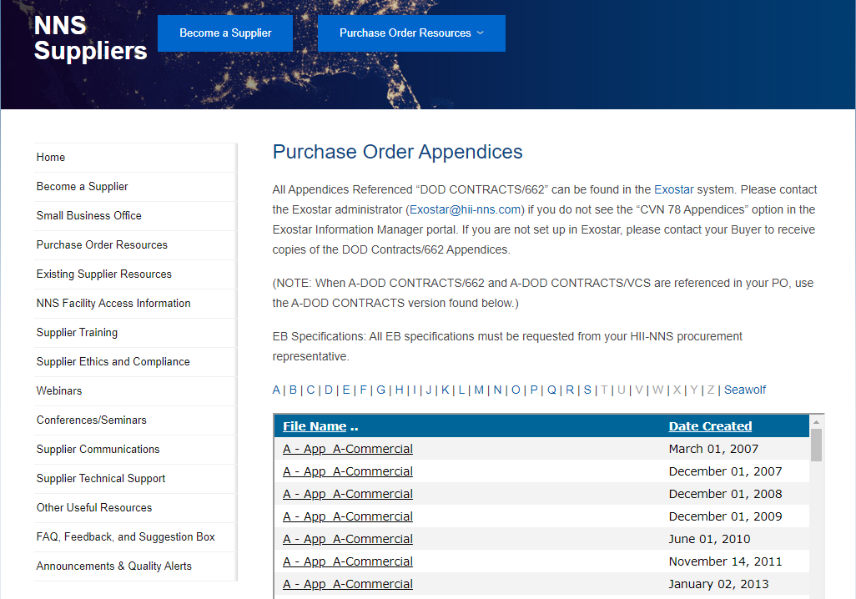
On-Boarding New Suppliers – Supplier Quality Continued
https://supplier.huntingtoningalls.com/sourcing/purchase-order-appendices/

Slide 29
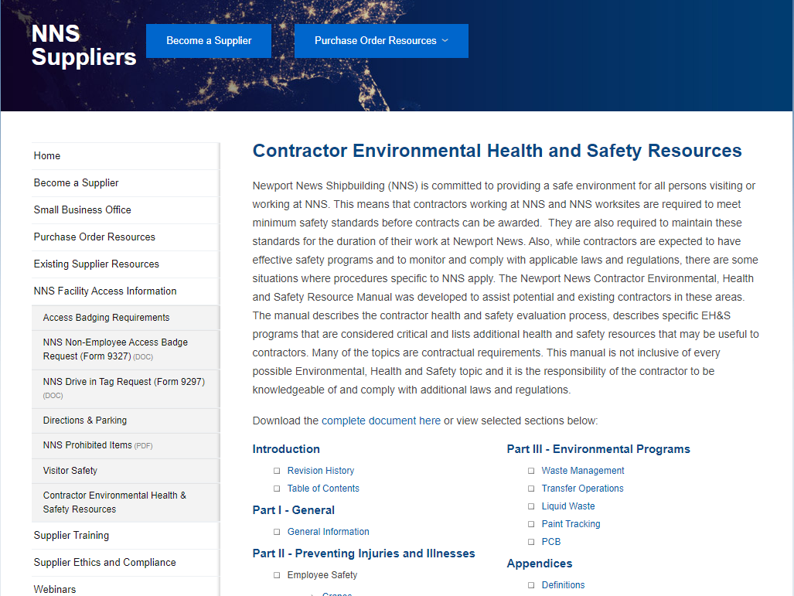
On-Boarding New Suppliers – Environmental Health & Safety
https://supplier.huntingtoningalls.com/sourcing/contractor-environmental-health-safety-resources/

Slide 30
NNS Supplier Base Process Continued
Second Base
Buying Offices are Notified that the Supplier is now in the Purchasing System
Buying Offices may Begin Issuing the Supplier Request for Quotes (RFQs)
Receiving a RFQ Advances the Supplier to 3rd Base
Third Base
After Receiving the RFQ, the Supplier Should:
Review the RFQ Fully to Ensure Understanding of all Requirements
Submit its Quote by the Quote Deadline
Provide all Requested Information Such as Price, Delivery Date, etc.
Clearly Note any Exceptions to the Requirements in the RFQ
Contact the Buyer With Questions
NNS will Evaluate Quotes for Technical Compliance and Best Value
Home Plate (Score)
When NNS Awards the Supplier a Purchase Order/Subcontract, the Supplier Advances to Home Plate and Scores

Slide 31
Ethics and Compliance
NNS is Committed to Complying With Applicable Laws, Regulations and Standards
Performing Ethically and With Integrity is Every NNS Employee’s Responsibility
NNS has a Robust Ethics and Compliance Program Designed to:
Prevent, Detect and Remediate Misconduct
Reduce Likelihood that Employees will Rationalize and Engage in Bad Behavior
Charge Leaders with not Creating an Environment Where Employees Feel Pressure to Work Outside of Procedures to Meet Business Goals
Provide a “Safe” Way for Employees to Report Misconduct Without Fear of Retaliation
To be a Responsible NNS Supplier, NNS Needs you to Have this Same Level of Commitment
Ethics and Compliance Requirements are Invoked Through Terms and Conditions of Purchase Orders/Subcontracts
NNS has Information and Tools on its Supplier Website to Assist Suppliers With Developing/Enhancing Their Ethics and Business Conduct Processes

Slide 32
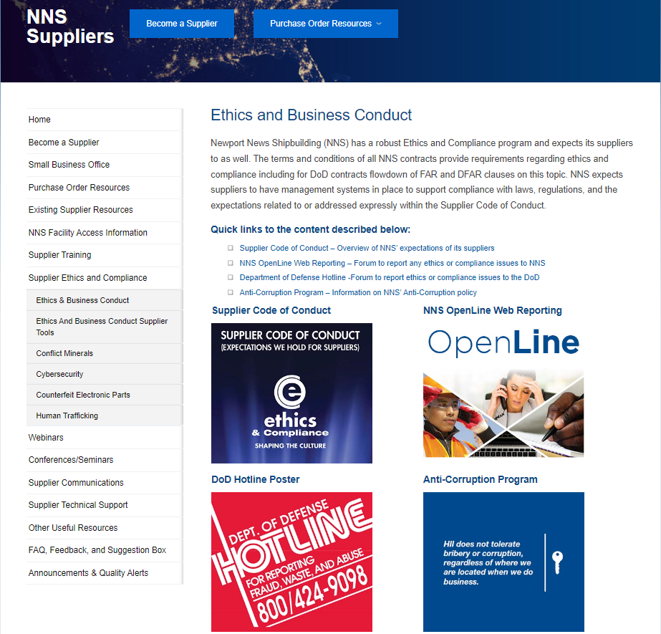
Supplier Ethics and Business Conduct Webpage
https://supplier.huntingtoningalls.com/sourcing/ethics-and-business-conduct/

Slide 33
NNS Supplier Responsibilities
Review and Understand all Requirements in NNS Subcontract/Purchase Order
Abide by all Applicable Laws and Regulations
Conduct all Business in an Ethical Manner
Provide Quality Products and/or Services
Provide Consistent On-time Delivery
Ensure all Tiers of the Supply Chain Understand Contractual Responsibilities Related to the Subcontract/Purchase Order
Continue to Look for Ways to Improve the Value of Your Products and Services

Slide 34
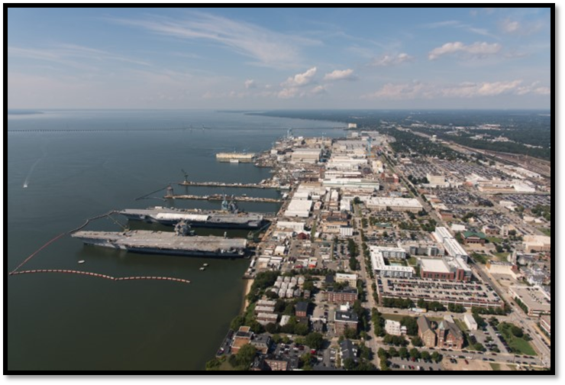
Supplier Code of Conduct; Expectations we hold for Suppliers

Slide 35
Commonly Asked Questions
How does a potential supplier find out about opportunities? NNS does not advertise opportunities. Current suppliers are made aware of opportunities through contact with their Supply Chain Management Buyer.
Do you have a tier 2 program? If so, how does it work? NNS does not have a Tier 2 program.
How does a supplier maintain a productive relationship with NNS? Consistent communication with Supply Chain Management (SCM) is important. Once on-boarded, build a relationship with the SCM buyer and communicate openly and honestly about your products, services and capabilities. When in doubt, ask questions. Don’t over extend your company. Connect with the Supplier Development department for training opportunities, diversify business products/services within HII Enterprise, and make sure you understand how to do business with NNS.
Does FAR (Federal Acquisition Regulation) and DFARS (Defense Federal Acquisition Regulation Supplement) apply to Indirect Procurements? No, FAR and DFARS are not applicable to indirect procurements.

Slide 36
Contact Information
Small Business Office
Katina Adams
Manager, Socio Economic Business Liaison
757-380-7011
Smallbusiness@hii-nns.com
NNS Prospective Supplier Program
Strategic Sourcing / Supplier Development Office
NNSProspectiveSupplier@hii-nns.com

Slide 37
37

