Slide 1
4th Quarter
Contractor Business Meeting
Facilities Session
December 5th, 2014
Yesika L. Kain
Plant Engineering

Slide 2
Agenda
New Contractor Crane Briefing
Sound Horn Before Passing Equipment Decals
Phones with Camera Capability
Shutdown Work
Inspection of Fall Protection Equipment
T&M ticket forms
Form 9630 Rev 2
Field Change Directive and Requests for Information Form
Outline Agreement Solicitations

Slide 3
Contractor Crane Briefing
Updated contractor lifting & handling operations briefing.
Rev D. July 2014
All contractors performing lifting & handling operations at NNS must attend the new briefing.
Operators and riggers.
NNS goal is to have all contractors who perform L&H operations to go through the briefing by June 2015.
Contact Yesika L. Kain (Yesika.L.Kain@hii-nns.com) or Jennings Spease (Jennings.Spease@hii-nns.com) to sign up for upcoming briefings.
The next crane briefing will be held December 8th at 8AM and 4PM at Building 4953.
Notes:
classroom holds 32 attendees
we have had 4 classes
NCC review of our L&H program is scheduled for June

Slide 4
Sound Horn Before Passing Equipment Decals
Contractor owned equipment.
Decals are available for your use.

Slide 5
Phones with Camera Capability
Cell phones with photo capability are not permitted anywhere in the shipyard.
This restriction applies even if the camera function has been disabled.
Any phone found to have camera capability will be turned over to Security for investigation and disciplinary action will be taken.

Slide 6
Shutdown Work
The holiday shutdown will be from Wednesday, December 24th through Sunday, January 4th.
If your company is working through shutdown, review your current NNS work permits with your contractor coordinator/field engineer.
Only emergency and essential personnel will be onsite therefore permit requests and renewals will be postponed until the first week of January.
Excavation permits, Hot/Cold Work permits, etc.
Deliveries where the driver has to be escorted into the yard will be postponed until the first week of January.
List of companies and locations of work during shutdown.

Slide 7
Inspection of Fall Protection Equipment
INSPECT ALL FALL PROTECTION EQUIPMENT PRIOR TO USE.
If at any time you see the red fall indicator deployed on any fall protection equipment, DO NOT use the equipment.
The red indicator means that this device has been subjected to a fall.
If the red fall indicator is visible remove the device from the job site.

Slide 8
NNS Standard Construction Time-and-Material Ticket Forms
The NNS Standard Time-and-Material Ticket shall be used to document all T&M work performed on NNS contracts.
Construction services T&M tickets must be submitted to the Contractor Coordinator/Field Engineer with in 5 business days of the date on the ticket.
Construction Services T&M Daily Ticket Form 9628 Rev 0
Form can be found at:
http://supplier.huntingtoningalls.com/sourcing/docs/forms/NN_9628-Contsruction_Services_TandM_Daily_Ticket_Rev_0.xlsx
All fields must be completed prior to submittal to NNS.
All subcontractor and purchased material back-up must be attached to the T&M ticket.
All rates and categories must match those established on the outline agreement.

Slide 9
NNS Standard Engineering Time-and-Material Ticket Forms
The NNS Standard Time-and-Material Ticket shall be used to document all T&M work performed on NNS contracts.
Engineering Services T&M Weekly Ticket Form 9629 Rev 0
A fully completed T&M ticket shall be submitted weekly to the NNS Engineer.
Form can be found at: http://supplier.huntingtoningalls.com/sourcing/docs/forms/NN_9629-Engineering_Services_TandM_Material_Weekly_Ticket_Rev_0.xlsx
All fields must be completed prior to submittal to NNS.
All subcontractor and material purchased back-up must be attached to the T&M ticket.
All rates and categories must match those established on the outline agreement.

Slide 10
Form 9630 Rev 2
Used for releases against outline agreements and T&M Change Orders
Form can be found on: http://supplier.huntingtoningalls.com/sourcing/docs/forms/NN_9630_Rev2_Form_of_bid_for_TandM_Proposal.xlsx
Section 1 is completed by NNS
Section 2 is completed by vendor
Basis for estimate and milestones
Notes:
Page one has two main sections:
Section 1 to be filled out by NNS. Must include a detailed scope of work, deliverables, and the time frame in which the work will be completed.
Section 2 to be filled out by supplier which summarizes the cost and schedule which are broken down in the subsequent pages.

Slide 11
Field Change Directive and Request for Information (FCD/RFI)
The FCD/RFI form is used when changes can affect cost, schedule, and deliverables.
Section 1 and 4 are filled out by the contractor.
Section 2 is filled out by the NNS engineer.
Section 3 is filled out by NNS procurement office.
Form NN 9631 Rev 1
Can be found at: http://supplier.huntingtoningalls.com/sourcing/docs/forms/NN_9631_Rev_1_RFI_FCD.xlsx

Slide 12
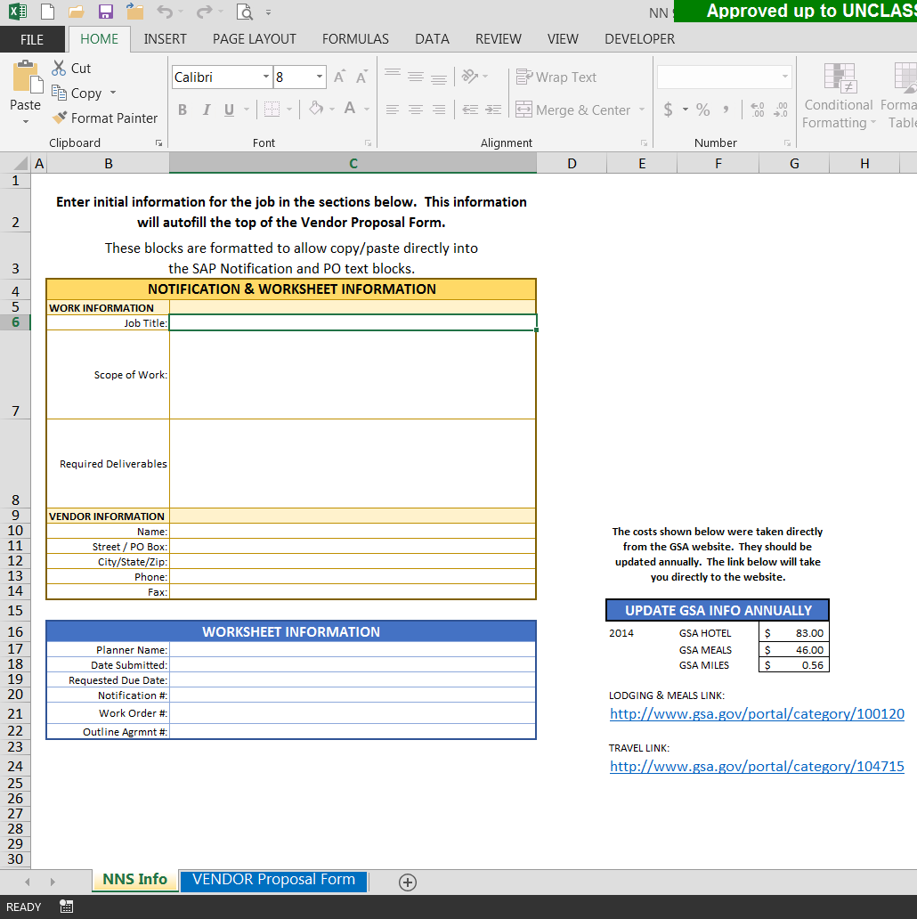
Contract Worksheet
TAB 1 “NNS Info”
Initial information filled in by NNS
TAB 2 “VENDOR Proposal Form”
Yellow fields filled in by vendors. All sums total on front page.

Slide 13
Outline Agreement Solicitations
The following Outline Agreement Solicitations will be posted on the NNS Supplier website.
located at http://supplier.huntingtoningalls.com/sourcing/index.html
Heavy Industrial and Marine Construction
Piping Services
Asbestos & Lead Abatement, Mold Remediation, Mechanical Insulation, Misc. Construction
New Construction, Renovations, Repairs, Miscellaneous Construction Projects
Rigging and Millwrights
Repair and Install Doors
Crane and Rigging Services
The bid response period is December 5, 2014 through January 5, 2014, 4:00PM EST.
All questions and responses must be submitted to FacilitiesServices@hii-nns.com
Please ensure that you send all requests for information related to this solicitation NLT noon, December 19, 2014 to http://supplier.huntingtoningalls.com/sourcing/index.html. All NNS responses will be posted here.

Slide 14
QUESTIONS?
Please submit your questions related to sourcing topics at the following e-mail address:
Facilitiesservices@hii-nns.com
If you have questions regarding this presentation, please contact your Contract Coordinator/Field Engineer or:
Yesika L. Kain
757-353-2772
Yesika.L.Kain@hii-nns.com
This presentation will be posted on the public NNS website for your reference.

