Slide 1
4th Quarter
Contractor Business Meeting
Facilities Session
January 9th, 2014
Yesika L. Castro-Hernandez
Plant Engineering

Slide 2
Agenda
Fall Protection
Seat Belts and Seats
Temporary Canopy Use Guidelines
Red Wing Boot Recall
Contractor Lifting and Handling Operations
Standard T&M Sheet
Construction T&M
Engineering Services T&M
STOP Cards

Slide 3
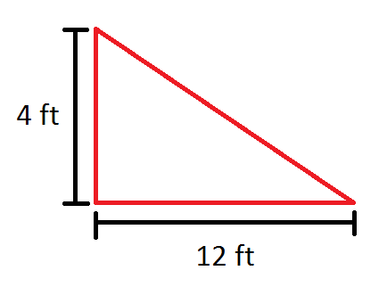
Fall Protection
Fall protection is required:
When employees are more than 5 feet above a solid surface that is not guarded.
On unguarded surfaces 15 feet or more above water.
In personnel floats (JLG, skiffs, baskets) over solid surfaces, or 15 feet or more over water.
When a walking/working surface slope is greater than or equal to four in twelve (4 foot vertical run to 12 foot horizontal run) a fall arrest system must be used.
Fall restraints may not be used.
Fall arrest anchorage points used to secure lifelines, lanyards or deceleration devices must be able to support 5000lbs.
NNS best management fall protection practices for work over water and in aerial lifts are:
Life jacket required on unguarded surfaces less than 15 feet above water.
Life jacket required when less than 15 feet above water riding in personnel float (aerial lifts, skiffs, and basket).
Notes:
A fall arrest system provides maximum freedom of movement for workers to conduct their duties. In doing so it allows them to reach the point where a fall could occur. However, in the event of a fall, the fall will be arrested and so allow the person to either effect a self-rescue or be rescued.
Fall restraint systems allow a person access to conduct their duties but prevent them from reaching a point where a fall could occur.

Slide 4
Fall Protection
D-rings, snap hooks, vertical lifelines, and lanyards shall be capable of sustaining a minimum tensile load of 5,000 pounds. [1915.159(a)(3) & 1915.159(b)(2) ]
Self-retracting lifelines and lanyards that automatically limit free fall distances to 2ft or less shall be capable of sustaining a minimum tensile load of 3,000 pounds applied to a self-retracting lifeline or lanyard with the lifeline or lanyard in the fully extended position. [1915.159(b)(3) ]
Self-retracting lifelines and lanyards which do not limit free fall distance to 2ft or less, rip stitch lanyards and tearing and deforming lanyards shall be capable of sustaining a minimum static tensile load of 5,000 pounds applied to the device when they are in the fully extended position. [1915.159(b)(4) ]

Slide 5
Seat Belts and Seats
Seat belts shall be worn by the motor vehicle operator and all passengers any time the motor vehicle is in operation on company property, and all privately owned motor vehicles when operated on company property. Each motor vehicle used to transport people must have a firmly secured seat for each person being transported.
When equipped, seat belts shall be worn by any employee operating mobile equipment (i.e., forklifts and mobile cranes) at any time such equipment is in operation, on or off company premises.
Motor vehicle passengers are limited to the number of seats and seat belts provided. Passengers are prohibited from riding in the bed of a truck under any circumstances.

Slide 6
Temporary Canopy Use Guidelines
“pop up” style canopies may be utilized at the shipyard following these guidelines:
Canopy must be “pop up” style, which can be easily set up and taken down. Maximum allowable size is 10’x10’.
Owning Department or Contractor has ultimate responsibility for its use.
Canopy must be in use to remain set up. The canopy is considered in use, as long as work is ongoing and the canopy is not unattended for more than 15 minutes. The canopy may be left set up during lunch, if it is monitored.
Take down canopy and store at the end of the shift if it will not be used by the next shift or when the canopy is not in use for more than 15 minutes.
Each canopy leg shall have a weight bag system with 40 pounds of sand, see image below. Do not use anchoring spikes or anything that penetrates the ground.
Take down with any sign or onset of severe weather, or where winds may be in excess of 25 MPH sustained.
Acceptable canopy manufacturers are EZ-Up® Instant Shelter Eclipse 2 model and Ozark Trail®. Weight bags are to be purchased from the canopy manufacturer.

Slide 7
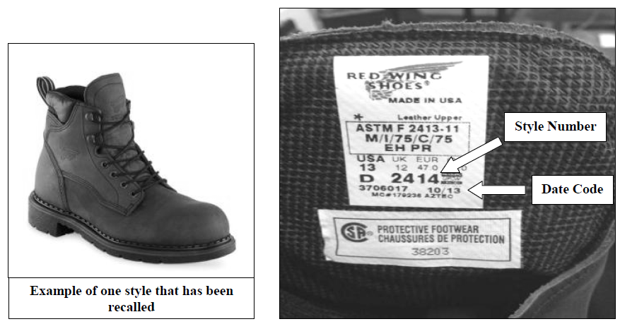
Red Wing Boot Recall
Steel Toe Work Boot Recall
Red Wing Shoes® has been instructed by the United States Consumer Product Safety Commission to recall 45 styles of Red Wings® men’s steel toe work boots due to an impact hazard. The steel toe cap in the boots could fail to protect your feet in an impact. The recall includes sizes 11-18 and widths B-H. The boots that have been recalled have 6, 8, 10, or 11 inch ankle height and are colored brown, black, and maroon.
Red Wing Shoes ® steel toe work boots with the following style numbers have been recalled:
2206, 2211, 2223, 2226, 2230, 2238, 2249, 2254, 2270, 2404, 2405, 2406, 2408, 2412, 2414, 2426, 2491, 3505, 3507, 3508, 3526, 3528, 3568, 4208, 4210, 4273, 4406, 4414, 4425, 4433, 4435, 4436, 4437, 4438, 4445, 4481, 4483, 4484, 4494, 22406, 22408, 52406, 52408, 82406 and 82408. Date codes between 10/12 and 11/13 are included in the recall.
To find the style number and date code, simply look at the label inside the boot’s tongue. If your steel toe work boots are included in the recall, please discontinue use and replace them. For more information on the recall, visit the following website: http://www.cpsc.gov/en/Recalls/2014/Red-Wing-Shoes-Recalls-Steel-Toe-Work-Boots/.

Slide 8
Contractor Crane Operations - Surveillance
In addition to surveillance of the actual performance of the L&H evolution, contractor crane operations may be audited at any time while on Newport News property to ensure:
Certificate of Compliance is properly completed & displayed on the crane.
ODCL was properly completed and retained.
All installed safety devices are operational.
The operator understands how to report a crane accident.
Equipment OSHA inspections and tests are up-to-date.
A completed lift plan is on site and being used.

Slide 9
Typical Contractor Crane Observations for 2013
Improper Rigging
Using damaged slings
Failing to use packing or tagline when it was needed
Lifting unbalanced loads
Side pull on the rigging gear
Using incorrect shackle size
No (or Inadequate) Lift Plans
Failure to have a lift plan on job site
Failure to provide complete details and/or process to make a successful lift on a lift plan.
Inadequate risk assessment and mitigation
Did not pre-brief the job with crew
Operator Error
Talking on cell phone while operating crane
No operators daily check list (ODCL) performed
Not knowing the weight of the job
Working Under/On Load
Passing loads over people’s head
Allowing personnel to work on or under a suspended load
Travel Path
Parking vehicles in yellow travel path
Leaving material in yellow travel path

Slide 10
Lift Plans - Requirements List
Yard-wide L&H requirements for departments working with contractors. Lift plans are required
for all suspended loads. This includes loads suspended from cranes, forklifts, backhoes, etc.
Load weight & C.G. information
- at boom length and angle being utilized
Lifting Equipment attributes - WLL and radius (if applicable)
- cranes, forklifts, backhoe or bucket truck attachment rig, etc
Rigging gear WLL in the configuration being used
- type, material, manufacturer, angle
- decreased capacity based on angle
Load attachment point information in the configuration being used
- temporary pads, SHR’s, eyebolts, etc
- number of lift points and distance from CG
Show calculations performed for determining reduced capacity
- sketch of rigging configuration
Lift sequence list
Recognize, Evaluate & Control (Risk Assessment) information.
- Are there any Pinch points? - Will weather be a factor?
- Is the travel path clear? - Are tag lines needed?
- Land site ready to receive load? - Will chain hoists be used?
- What is the communication method? - How will we control the hazards?
- Have all crew members been briefed on the job and their responsibilities?
- Are there lessons learned from other lifts that are applicable to this one?
Notes:
Critical Lifts:
75% capacity or greater
Lifting essential/expensive equipment
Lifting people with cranes
Planned Contact:
Due to space or job constraints, the load might make contact with its surroundings. Before making the lift L&H Quality team must be notified.
Always perform a second check prior to lifting equipment/material.
Strongly urged to perform lifts under 75% crane capacity.
Lifts above 75% capacity are considered critical lifts.
Check gear before every use.
Current Inspection tag within inspection date.
Surface cracks, cuts, or gouges.
Evidence of heat damage.
Excessive wear.
Core protrusion in straight runs.
Severe kinking or crushing.
Any sign of possible damage
Risk Assessment
Pinch Points
Weather conditions (i.e. limited visibility, high winds, cold temps)
Travel path of load
Landing site

Slide 11
Lift Plans
Every lift shall have a properly written lift plan.
All lift plans must be reviewed and signed by your Foreman or Supervisor.
Support information must be included with the lift plan (calculations, drawings, etc.).
All hazards and actions to minimize or eliminate them shall be listed on the plan.
If there is going to be “incidental” contact of the load and surrounding structures it must be approved by L & H Quality and written on the lift plan prior to starting the job. (contact contractor coordinator to get approval).
Unplanned contact is an accident, damage or no damage.
Incidental contact that has been pre-approved by the L&H Quality Group prior to initiating the lift is not considered an accident unless the contact results in damage.
If any part of the hook, block, hauling wire, or rigging gear will make ANY contact with ANTYHING it must be approved by X36 Technical (engineering) before the lift can be made.
If conditions change, revise the plan and record changes in the “Lessons Learned” section.
Work the job as it has been detailed in the lift plan.
All Lift plans must be reviewed and briefed before the lift is made.
If you have any questions or require assistance in writing your lift plan, don’t hesitate to call.
L & H Quality contact ---Lee Edmunds… 688-7755 (Office) or 757-912-6521 (cell)
X36 Technical contact---Jennings Spease…688-9988 (office) or 747-869-5122 (cell)

Slide 12
Brief the Lift Plan and the Job Being Performed
A successful lift begins with a well-written lift plan. However, the most detailed lift plan is only as effective as the pre-job brief that communicates the details to the entire team. Everyone involved in the lift, including trades personnel, must be involved in the briefing. A good briefing assumes nothing and covers everything related to the lift. At a minimum all pre-job briefs shall include the following:
Discuss the crucial information on the lift plan – load weight, CG, type and capacity of gear and equipment, lift points.
Make sure all gear and equipment is listed, available and in compliance with safety guidelines.
Discuss the entire operating envelope – lift site, travel path, landing site, close tolerances - and check that all areas are clear.
Talk to the team about the risks and hazards of the job and ways to avoid or eliminate them.
Identify past problems with this type of lift. Look at “lessons learned” from similar lifts.
Review the job and ask open-ended questions to ensure all team members, including trades personnel working the job with you, understand their responsibilities in the operation and how they will accomplish them.
Anticipate problems and discuss the conditions under which the work will “STOP!”
If conditions change, STOP, revise the lift plan and re-brief the team.
Pre Job Briefing is Not an Option. It is a requirement!

Slide 13
Definition of a Reportable Crane Accident
An accident occurs when any one or more of the elements in the envelope of operation fails to perform correctly during the L&H operation, including operation during maintenance or testing resulting in the following:
(a) Personnel injury or death.
(b) Material or equipment damage
(c) Dropped load
(d) Derailment
(e) Two-blocking
(f) Overload
(g) Collision, including unplanned contact between the load, crane and/or other objects.

Slide 14
Lifting and Handling (L&H) Accident Reporting
In the event of a L&H accident, as a contractor you must:
Stop work immediately and secure the site! Do not alter the scene of the accident unless it is necessary for the safety of personnel or property!!!!
Call *911 (from Shipyard phones) or 380-2222 (from cell phones) for emergency assistance, if needed.
Call 688-9888 to report the accident to the Facilities Service Desk. The Facilities Service Desk will notify the Newport News Crane Accident Response Team.
Keep all persons not involved with the accident away from the area. Make sure that anyone who was involved or has knowledge of the accident remains near the area.
Involved personnel must remain on-site until released by the Crane Accident Response Team, even if it means working past the end of their shift.
Wait for the Crane Accident Response Team to arrive.
Remember, your responsibilities are not optional! If you are questioning whether an accident has occurred, your next action should be to call it in and let the L&H Accident Response Team investigate the incident and make the determination!
Notes:
While no one wants to go through the process of an accident investigation, it is very important for us to consider the consequences of not reporting an incident immediately. It could have adverse results later on if the accident is not reported as unforeseen damage to a ships component, rigging gear or crane equipment, that does not get identified, can lead to another incident or someone getting injured.

Slide 15
NNS Standard Construction Time-and-Material Ticket
The use of the NNS Standard Construction Time-and-Material Ticket (F-040-7) will be mandatory starting January 15, 2014.
A fully completed T&M ticket shall be submitted daily to the NNS Field Engineer.
A blank Microsoft Excel 2007 formatted version will be provided to the Contractor by the coordinators.
All fields must be completed prior to submittal to NNS.
All subcontractor and purchased material back-up must be attached to the T&M ticket.

Slide 16
NNS Standard Engineering Time-and-Material Ticket
The use of the NNS Standard Engineering Time-and-Material Ticket (F-040-10) will be mandatory starting January 15, 2014.
A fully completed T&M ticket shall be submitted weekly to the NNS Engineering representative.
A blank Microsoft Excel 2007 formatted version will be provided to the Engineering Service Provider.
All fields must be completed prior to submittal to NNS.
All subcontractor and purchased material back-up must be attached to the T&M ticket.
ENGINEERING SERVICES TIME AND MATERIAL WEEKLY TICKET Newport News Shipbuilding (NNS) - A Division of Huntington Ingalls Industries |  |  |  |  |  |  | Project Title |  | 0
THIS SHEET SHALL BE COMPLETED AND SUBMITTED TO NNS Weekly |  |  |  |  |  |  |  |  |  | Period | 11/18/2013 | - | 11/24/2013
Vendor Job ID |  | 0 | PO # | 0 |  | PO Item # | 0 | Buyer's Representative |  | 0
Contractor Name: |  | AAA Services |  |  |  | Notification | 0 | Work Order | 0 |  | Sheet # | Sheet1
Contractor Address: |  | 123 Somewhere Street, Somewhere, Va. 233333
Contractor Phone: |  | Off - 757-555-5555
Contractor Fax: |  | Fax - 757-555-6666
Daily Work Description: |  | Monday, November 18, 2013
 |  | Tuesday, November 19, 2013
 |  | Wednesday, November 20, 2013
 |  | Thursday, November 21, 2013
 |  | Friday, November 22, 2013
 |  | Saturday, November 23, 2013
 |  | Sunday, November 24, 2013
LABOR |  |  |  | Mon | Tue | Wed | Thu | Fri | Sat | Sun | Total
Employee |  | Classification | Rate | 18-Nov | 19-Nov | 20-Nov | 21-Nov | 22-Nov | 23-Nov | 24-Nov
 |  | - | - |  |  |  |  |  |  |  | -
 |  | - | - |  |  |  |  |  |  |  | -
 |  | - | - |  |  |  |  |  |  |  | -
 |  | - | - |  |  |  |  |  |  |  | -
 |  | - | - |  |  |  |  |  |  |  | -
 |  | - | - |  |  |  |  |  |  |  | -
 |  | - | - |  |  |  |  |  |  |  | -
 |  | - | - |  |  |  |  |  |  |  | -
 |  | - | - |  |  |  |  |  |  |  | -
 |  | - | - |  |  |  |  |  |  |  | -
 |  | - | - |  |  |  |  |  |  |  | -
 |  | - | - |  |  |  |  |  |  |  | -
 |  | - | - |  |  |  |  |  |  |  | -
 |  | - | - |  |  |  |  |  |  |  | -
 |  | - | - |  |  |  |  |  |  |  | -
 |  | - | - |  |  |  |  |  |  |  | -
 |  | - | - |  |  |  |  |  |  |  | -
 |  | - | - |  |  |  |  |  |  |  | -
 |  |  |  |  |  |  | Subtotal |  |  |  | $0.00 |  | $0.00
 |  |  |  |  |  |  | Labor Mark-up (%) |  |  | 0% | $0.00 |  | $0.00
 |  |  |  |  |  |  | Total Labor |  |  |  | $0.00 |  | $0.00
LODGING & MEALS (Per GSA Rates) / Invoice or receipt must be attached to this sheet |  |  |  |  |  |  |  |  |  |  | Total
Description |  |  | Date(s) |  | GSA Allowable Rate |  | Actual Rate / Cost |  | Taxes
 |  |  | - |  | - |  | - |  | - |  | -
 |  |  | - |  | - |  | - |  | - |  | -
 |  |  | - |  | - |  | - |  | - |  | -
 |  |  | - |  | - |  | - |  | - |  | -
 |  |  | - |  | - |  | - |  | - |  | -
 |  |  |  |  |  |  | Subtotal |  |  |  | $0.00 |  | $0.00
 |  |  |  |  |  |  | Mark-up (%) |  |  | 0% | $0.00 |  | $0.00
 |  |  |  |  |  |  | Total Lodging & Meals |  |  |  | $0.00 |  | $0.00
SUBCONTRACTORS
Vendor |  |  |  | Description |  |  |  | Invoice Number |  |  | Total
 |  |  |  |  |  |  |  |  |  |  | -
 |  |  |  |  |  |  |  |  |  |  | -
 |  |  |  |  |  |  |  |  |  |  | -
 |  |  |  |  |  |  | Subtotal |  |  |  | $0.00 |  | $0.00
 |  |  |  |  |  |  | Mark-up (%) |  |  | 0% | $0.00 |  | $0.00
 |  |  |  |  |  |  | Total Subcontractors |  |  |  | $0.00 |  | $0.00
MATERIAL Fixed Price (Per PO / Outline Agreement) |  |  |  |  |  | MATERIALS PURCHASED (Invoice Required)
Quantity | Unit | Description |  | Unit Price | Total | Vendor | Description |  |  | Invoice # | Total
 | - |  |  | - | - |  |  |  |  |  | -
 | - |  |  | - | - |  |  |  |  |  | -
 | - |  |  | - | - |  |  |  |  |  | -
 | - |  |  | - | - |  |  |  |  |  | -
 | - |  |  | - | - |  |  |  |  |  | -
 | - |  |  | - | - |  |  |  |  |  | -
 |  |  |  |  |  |  | Inventory and Purchased Materials Subtotal |  |  |  | $0.00 |  | $0.00
 |  |  |  |  |  |  | Mark-up (%) |  |  | 0% | $0.00 |  | $0.00
 |  |  |  |  |  |  | Total Material |  |  |  | $0.00 |  | $0.00
 |  |  |  |  |  |  |  |  | Previous Total |  |  |  | $0.00
Contractor Approval |  |  |  |  |  |  | DATE: |  | Weekly Total |  |  |  | $0.00
(Ticket not Valid Unless Signed) |  |  |  |  |  |  |  |  | New Total |  |  |  | $0.00
Buyer's Representative: |  |  |  |  |  |  | DATE: |  | PO Amount |  |  |  | $0.00
(Ticket not Valid Unless Signed) |  |  |  |  |  |  |  |  | PO Amount Remaining |  |  |  | $0.00
Form No. F-040-10

Slide 17
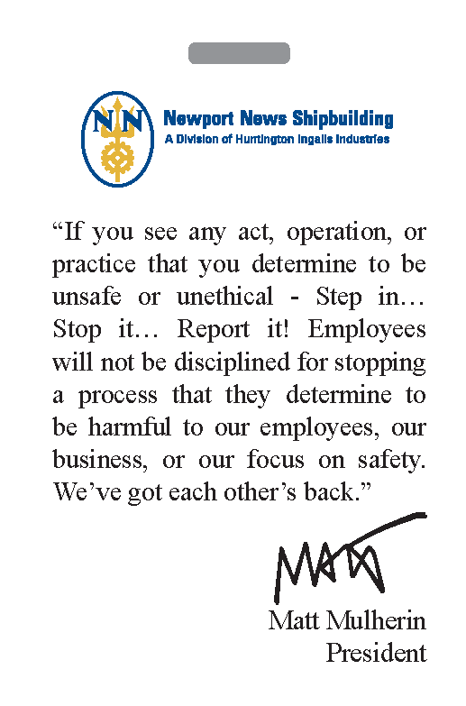
STOP Cards
“If you see any act, operation, or
practice that you determine to be unsafe or unethical - Step in… Stop it… Report it to your employer or Supervisor immediately!
I
100% Responsibility / 0 excuses
Only in Emergency:
Shipyard Phone: *911
Other Phone: 380-2222

Slide 18
QUESTIONS?
If you have questions regarding this presentation, please contact your Contract Coordinator or:
Yesika Castro-Hernandez
O41 – Plant Engineering
757-353-2772
Yesika.L.CastroHernandez@hii-nns.com

