Slide 1
1st Quarter
Contractor Business Meeting
Facilities Session
March 13th, 2015
Yesika L. Kain/Ben Mulherin
Plant Engineering

Slide 2
Agenda
Crane Accident from Travel Path Foul (Ben Mulherin)
Contractor Lifting and Handing (Jennings Spease)
PPE During Cold Weather (Rod Taylor)
Aerial Equipment (Rod Taylor)
Speed Limit Change (Rod Taylor)

Slide 3
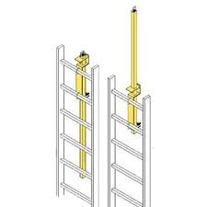
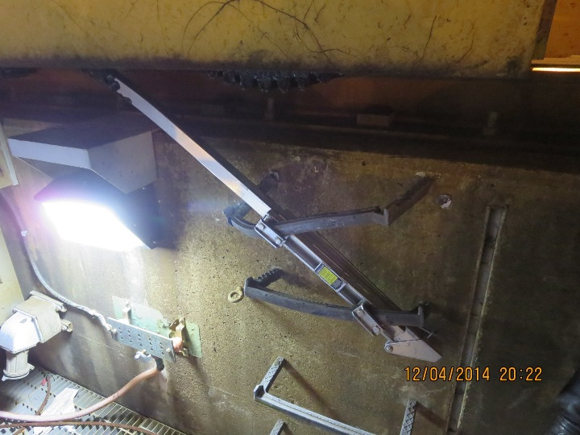
Crane Accident from Travel Path Foul
A crane crew was tasked with removing a JLG out of a Dry Dock using crane. While in the process of traveling the crane, the crane’s gear trucks made unplanned contact with a “ladder-up” that had been installed on catwalk of the dry dock. The contact caused damage to the “ladder-up”. There was no damage to the crane.
The crane path was walked and cleared to proceed by leg walkers prior to crane movement and the “ladder-up” was not identified in the “up” position.
“Ladder-up” devices have been removed in areas that will impact crane travel path.

Slide 4
Crane Accident from Travel Path Foul
The flowchart below describes the actions required to determine if the project will breach the crane envelope.

Slide 5
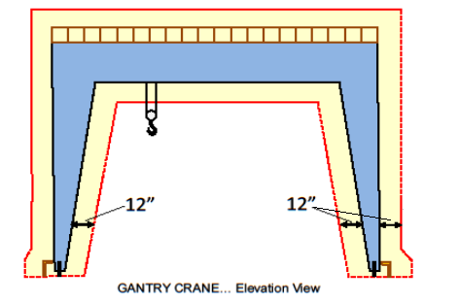
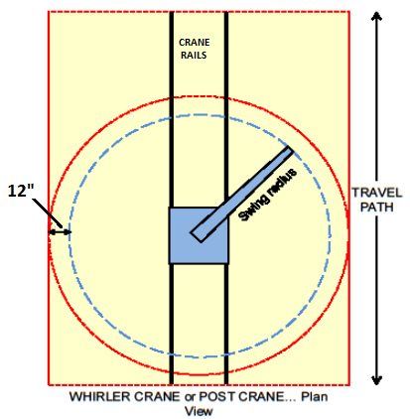
Crane Accident from Travel Path Foul
Per SOP O40-2.3 (Facilities Design Process) The figure below outlines the fouling parameters for a Gantry Crane and Whirler Crane or Post Crane operation
The two illustrated crane envelopes include the structure in blue and the buffer zone in yellow along the entire travel path or throughout the swing radius.
Do not exclude the envelope areas above the crane as well as along the sides and any space along the travel path as part of the crane envelope.

Slide 6
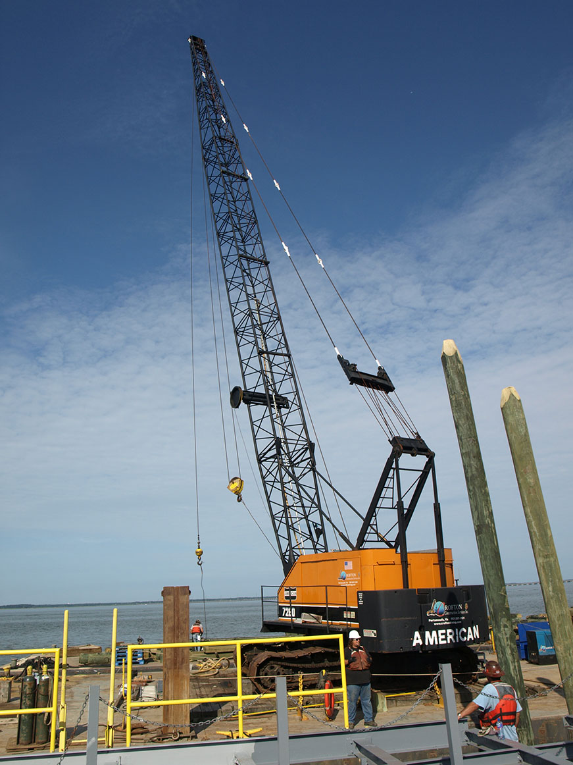
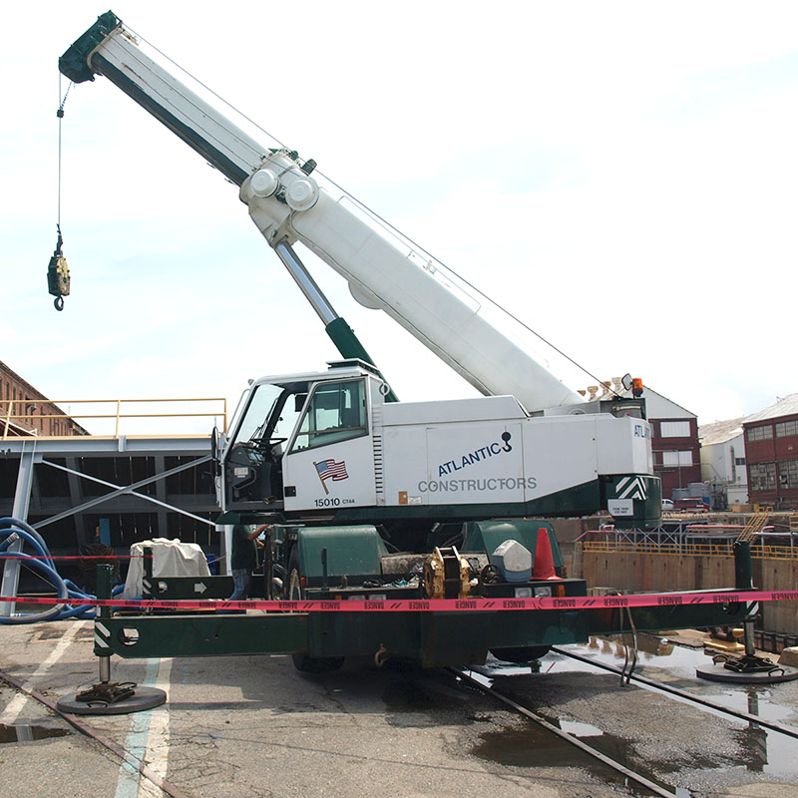
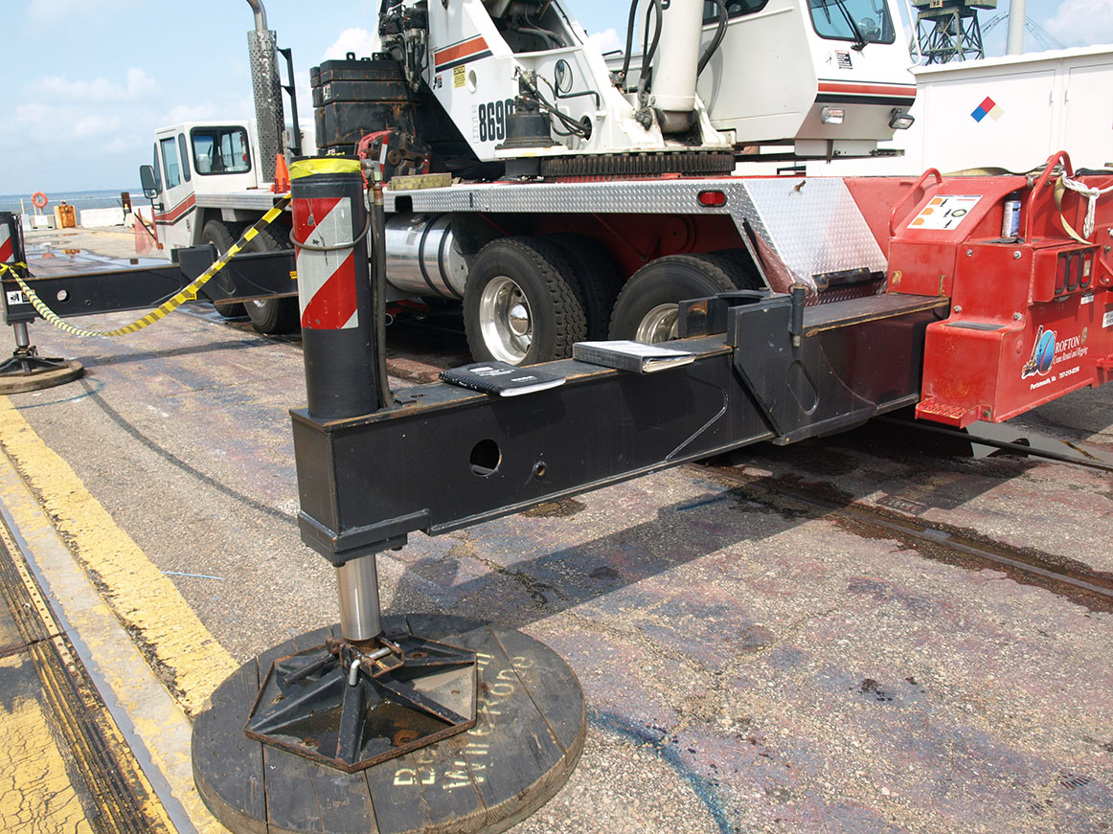
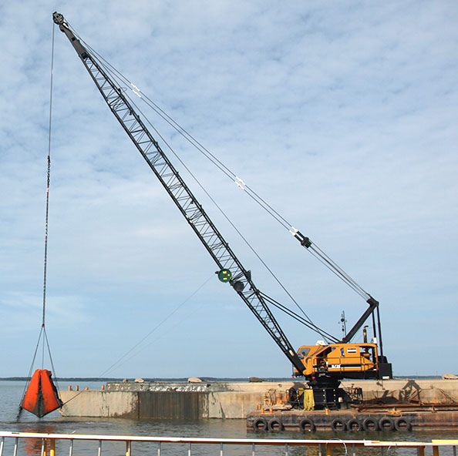
Contractor’s Lifting and Handling Briefing

Slide 7
Certificate of Compliance

Slide 8
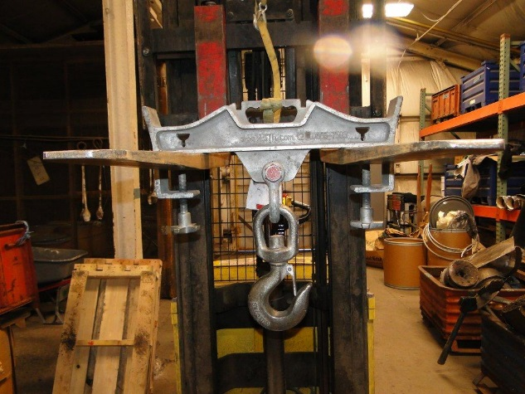
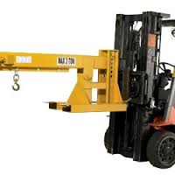
Forklift Attachments
1910.178(a)(4):Modifications and additions which affect capacity and safe operation shall not be performed by the customer or user without manufacturer’s prior written approval. Capacity, operation and maintenance instruction plates, tags or decals shall be changed accordingly.
1910.178(a)(5):If the truck is equipped with front-end attachments other than factory installed attachments, the user shall request that the truck be marked to identify the attachments and show the approximate weight of the truck and attachment combination at maximum elevation with load laterally centered.
1910.178(a)(6):The user shall see that all nameplates and markings are in place and are maintained in a legible condition.

Slide 9
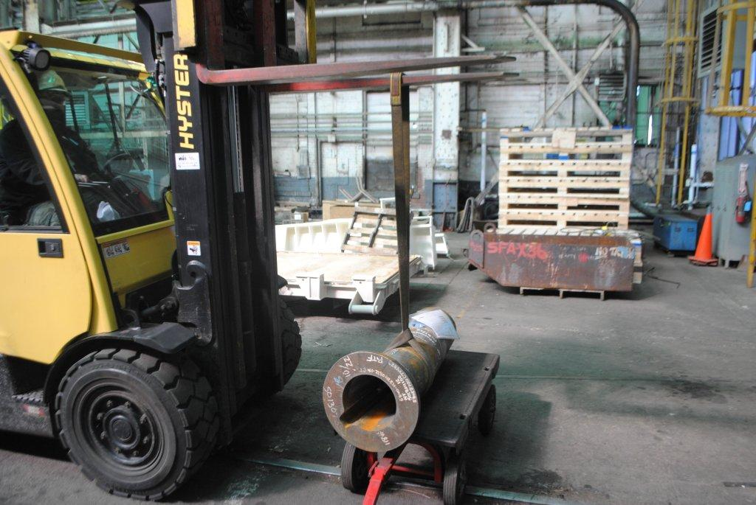
“Free Rigging”
Free rigging is the direct attachment to or placement of rigging equipment (slings, shackles, rings, etc.) onto the tines of a powered industrial truck for a below-the-tines lift. This type of lift does not use an approved lifting attachment.
Although free rigging is a common practice, it could affect the capacity and safe operation of a powered industrial truck. 29 CFR 1910.178(a)(4) requires that “Modifications and additions which affect the capacity and safe operation shall not be performed by the customer or user without manufacturers prior written approval. Capacity, operation and maintenance instruction plates, tags or decals shall be changed accordingly.
Information shown is from OSHA standard interpretations

Slide 10
If you cant get Manufacturer’s Approval
Employers must seek written approval from powered industrial truck manufacturers when modifications and additions affect the capacity and safe operation of powered industrial trucks. However, if no response or a negative response is received from the manufacturer, OSHA will accept a written approval of the modification/addition from a Qualified Registered Professional Engineer. A Qualified Registered Professional Engineer must perform a safety analysis and address any safety and/or structural issues contained in the manufacturer's negative response prior to granting approval. Machine data plates must be changed accordingly. Of course, the use of an approved attachment to make lifts would be a viable alternative for an employer who does not seek written approval from a manufacturer or a Qualified Registered Professional Engineer.
However, please be aware that OSHA would consider the lack of manufacturer's approval to be a de minimis violation if the employer has obtained written approval from a qualified Registered Professional Engineer after receiving no response or a negative response from the powered industrial truck manufacturer. If the manufacturer's response was negative, then the engineer, prior to granting approval for the modification or addition, would need to perform a safety analysis and address all safety and/or structural issues contained in the manufacturer's disapproval.
Information shown is from OSHA standard interpretations

Slide 11
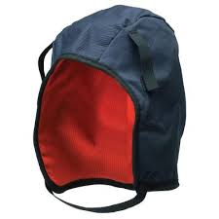
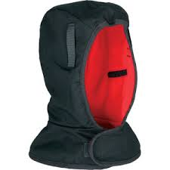
PPE During Cold Weather
During cold weather only approved items may be worn underneath hard hats.

Slide 12
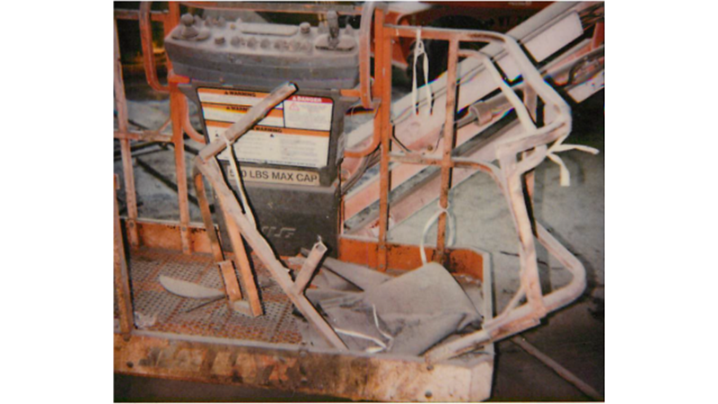
Aerial Lifts
Picture below is of damage to an NNS Aerial Lift

Slide 13
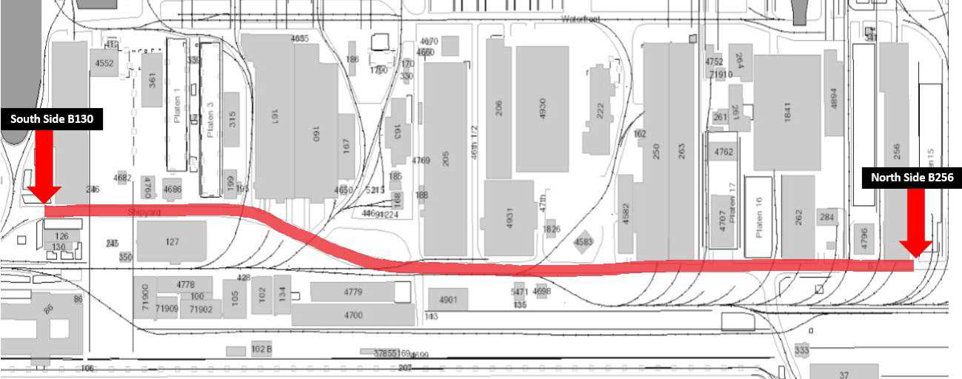
Speed Limit Change
The 10 mph speed limit zone has been extended from the north side of Building 256 to the south side of Building 103.

Slide 14
QUESTIONS?
Please submit your questions related to sourcing topics at the following e-mail address:
Facilitiesservices@hii-nns.com
If you have questions regarding this presentation, please contact your Contract Coordinator/Field Engineer or:
Ben Mulherin
757-380-3385
Benjamin.A.Mulherin@hii-nns.com
This presentation will be posted on the public NNS website for your reference.

